Slide 1


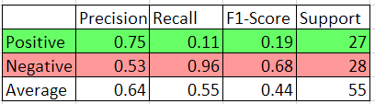

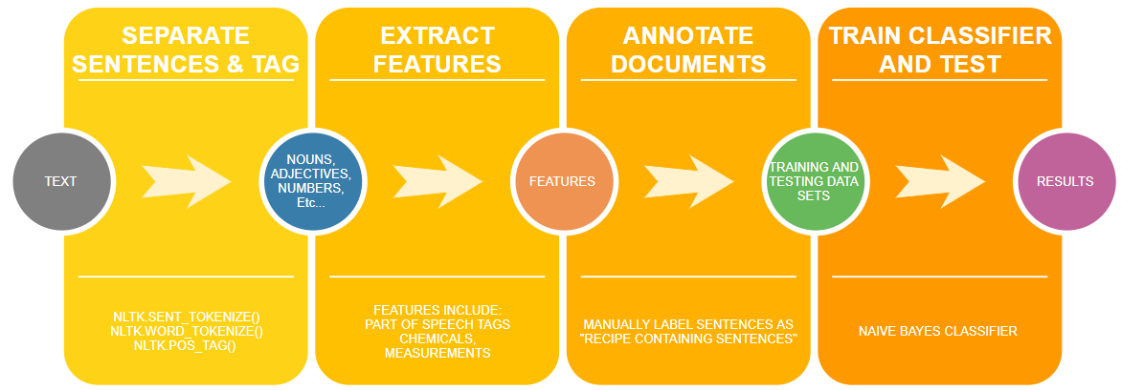
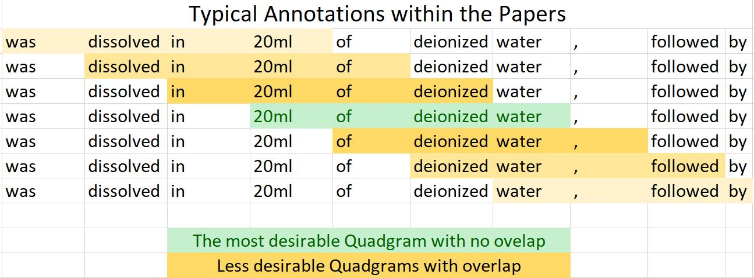
Identifying Sentences with Recipe information with Natural Language Processing
Erick Saenz-Gardea and Dr. William Hsu
Department of Computer Science and College of Engineering, Kansas State University
1. background
3. results
4. Summary/Interpretation
Natural language processing (NLP) is a branch of artificial intelligence that helps computers understand, interpret and manipulate human language. NLP software is used to translate text, identify spam in your email inbox, and identify relevant information online when using a search engine.
For a frame of reference, when reading text from another language, we may recognize letters, numbers, or punctuation, yet the underlying meaning is a complete mystery to us. With the help of NLP, computers can answer questions much more accurately, summarize entire documents, and quantify the connotation of an article.
The goal of this project is to determine whether a sentence contains a recipe step. We identify four features from the text: It’s semantics, digits, chemicals, and wikification possibilities (in-text entities that are found on Wikipedia pages). These features are then used to train the Naïve Bayes Classifier. Afterwards the classifier was tested on documents within the same field.
Naïve Bayes Classifier Results
Positives are examples of sentences that contain recipe information
Negatives are examples of sentences that do not contain recipe information
The Support Column informs us of how many sentences were used for this project
Detecting positives worked 75% of the time.
Collectively there are too many false positives being detected, henceforth the low recall rate of 11%
There is no correlation between wikification possibilities and the recipe containing sentences.
75% of the sentences have wikification possibilities
The average wikification possibilities are 3 per sentence
Our first attempts at identifying ingredient only were fairly successful due to the high F1-Score
Identifying Ingredients Results
All ingredients were correctly identified
There exists redundant repetition in the output that was not accounted for.
F1-Score is 0.7826
5. Future Work
For the future of this project we will look closer for the recipe components of the manufactured materials. This way, we may continue improving the previously developed algorithms to identify digits, chemicals, and semantics of the text. We will also use deep learning for labeling the role of an ingredient for recipe assembly. We should also continue to annotate more documents to see if the accuracy of this work improves. Typically, we see other projects of this nature use thousands of examples to train classifiers.
Alongside this we may also exclude the wikification feature due to it’s limited utility in identifying the recipe steps. We may also expand the measurement category to include Moles, molarity, and acidity (PH).
2. methods
Break the text into sentences and then extract every word in the sentence.
Tag the words with its Part of Speech identifier
Begin extracting features:
Chemical names and formulas via PubChemPy API
Digits (in terms of measurements such as 1 ml, 1 mg, and 1 kg)
Wikification possibilities
Manually Annotate the text and identify the recipe contain sentences for training/testing purposes.
Train the Naïve Bayes Classifier.
Test the Naïve Bayes Classifier.
Create additional algorithms to create Quadgrams.
Identify recipes via positioning.
6. Acknowledgments
The Knowledge in Databases and Discovery (KDD) lab led by Dr. Hsu
The Developing Scholars Program
The Ronald E. McNair Postbaccalaureate Achievement Program

